Slide 1
Social network analysis on proteins interactions in the human body
Project Report

Slide 2
- Aim:
The aim of this analysis is to see which proteins are the most important in the space (in the human body) and their role in fighting viruses and to study the interaction between them and visualize which of the nodes are more important in the proteins interaction network and we will use some of the measures and methods from our social network course
- Hypothesis:
We will use the node centrality analysis to see all four attributes of importance to each node, them being the degree centrality and the betweenness and closeness, and lastly the eigenvector which is the hardest one to get because it needs a bit more calculations and the project will go as follows

Slide 3



- Materials and tools we used for this project are:
Cytoscape: to visualize and to have the option if taking a subset when needed, and also for the ease of use since it has an interface
R Studio: we will use R to make sure our calculations are correct and accurate and above all be able to get all the centrality attributes in case Cytoscape fails to do so
As for excel: it’s just to view the files in a way everyone can read them and understand them

Slide 4
- What will the programs do:
Cytoscape to open and visualize the XML file for future use, and to be able to make a subset of the network which in our case here is very massive
In R Studio we used some outputs from Cytoscape to make all the calculations needed and how to get the final output
Excel will just show us the results/output and gives a way to interact with them

Slide 5
- Keep in mind!
For clarification: Cytoscape can take care of showing the degree and betweenness and closeness but as mentioned before the eigenvector will need more steps and we will use R for that
And with that we dive onto how we used our tools to analyze this dataset --→:

Slide 6
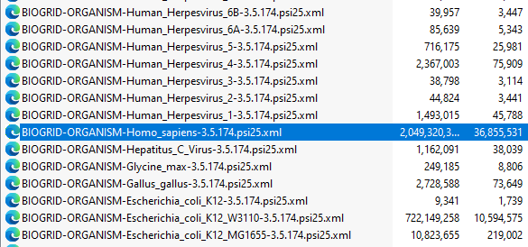
- What the input of the program will be?
The code that will convert the dataset file into readable Excel files that will see shortly….

Slide 7
- What the output of the programs will be?
1. Data Description
Our data set contains biological interaction data specific to the organism Homo sapiens (human) and is formatted in the PSI-MI 2.5 standard for protein-protein interaction data exchange, and was made by BioGRID

Slide 8
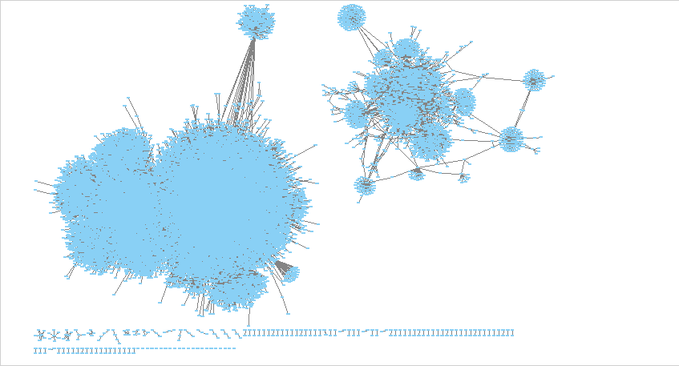
Our project steps and methods
We imported the XML file to Cytoscape as a network and it looks as such

Slide 9
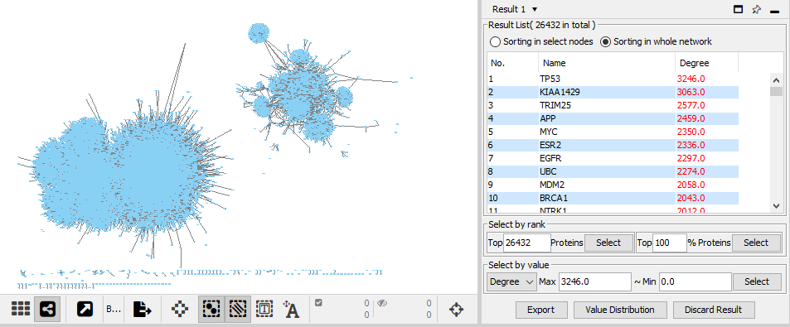
Admittedly the dataset is very massive and our computers can’t handle that level of calculations, so we will be taking a subset (even twice) to get a data we can work with we will be using the plugin “CytoNCA” to give us a frame of reference on which node we will use to make the subset

Slide 10
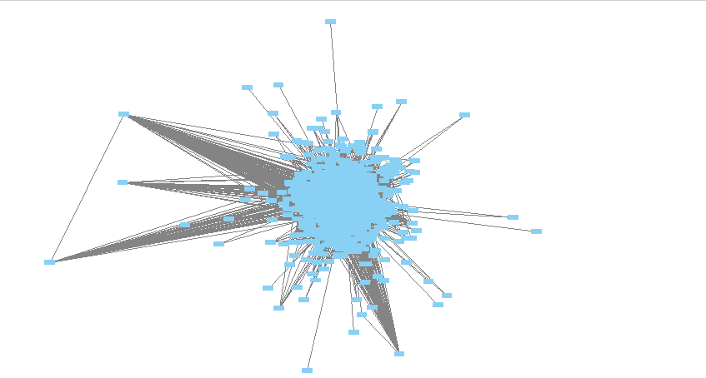
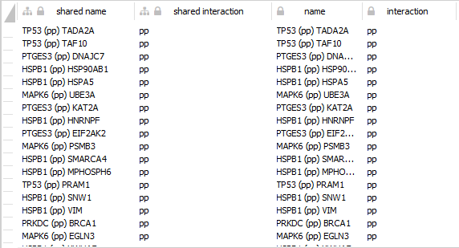
After we are satisfied with our new subNetwork we will extract the “edge table” into a CSV file and save it a place where R can access it (we will store it in documents)
For now other than visualizing our dataset we are pretty much done with Cytoscape and ready to move onto R studio and its codes

Slide 11
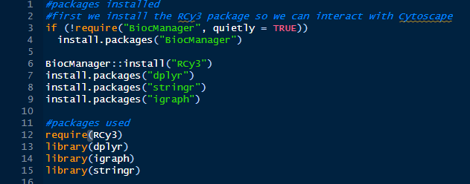
- Code Discussion:
Since at the time we didn’t know we could just plainly export the CSV file we had to take some “Extreme measures” it being using the following libraries

Slide 12
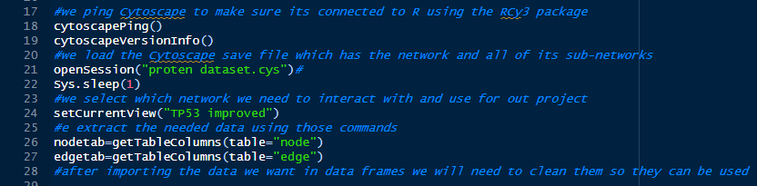

- Code Discussion:
Using Rcy3 package we were able to let R use and control Cytoscape as long as its open on the subnetwork view, we did that and were able to extract/pull all the data we need from the dataset opened in Cytoscape as follows

Slide 13
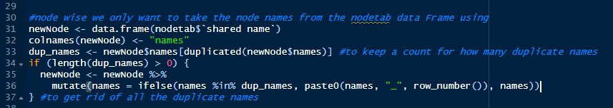
- Code Discussion:
Then we will need to do some data cleaning in a way that R can easily get us the results we want using them it will be split into two parts one for the nodes and one for the edge
1. For the nodes

Slide 14
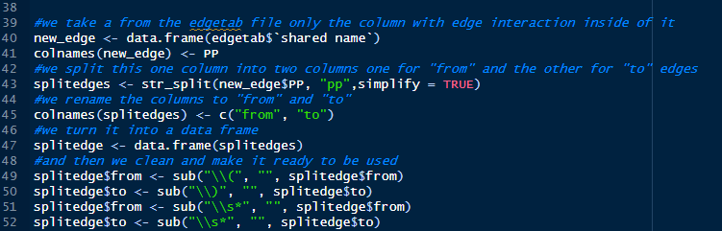
- Code Discussion:
2. Edges code

Slide 15
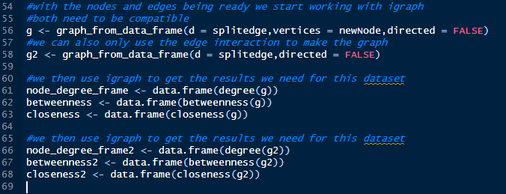
- Code Discussion:
After the cleaning is done we then use the (igraph) library to import both data frames to make the g or (graph inside a variable g and g2) as well as getting 3 of the four attributes we wanted

Slide 16
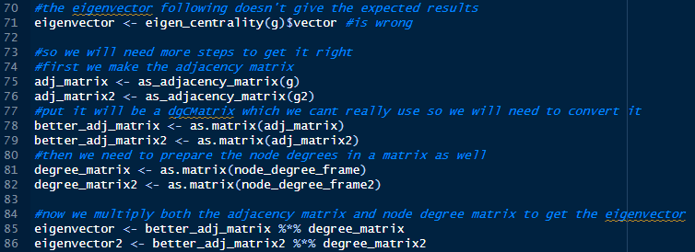
- Code Discussion:
We have one last attribute that we need to get which is the Eigenvector we think using the provided command gives false results so we decided to do it by ourselves, we did that by making the adjacency matrix of both graphs and we imported their degrees into another matrix following the formula provided in the course we should get the final and correct Eigenvector for both done as follows

Slide 17
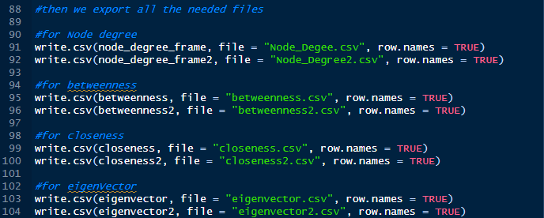
- Results:
After doing all of this we can now comfortable export our results from R as follows

Slide 18
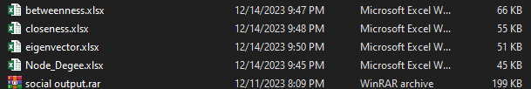
- Results:
Which will export to us these files (after converting them to excel files)
Before we go to our conclusion Let’s talk briefly about what each of the centralities mean given we are so close to us showcasing our final results

Slide 19
- Results(tangent)
1. Degree centrality
Degree centrality is about how many direct connections a node has with other nodes meaning a node becomes more important based on how many connections it has, the greater the better!

Slide 20
- Results(tangent)
2. Betweenness centrality
Betweenness centrality shows us when trying to reach a node from another node, how frequent some nodes will be on that path, the more they show up in the path means some of the other nodes are more likely to use that path as will making that node more important

Slide 21
- Results(tangent)
3. Closeness centrality
Closeness centrality shows us how much are some nodes are like bridges between clusters of nodes, meaning if a node has low closeness that would account into them being closer to most of the network parts making them a reliable path for the entire node

Slide 22
- Results(tangent)
4. Eigenvector centrality
Eigenvector centrality is the importance of a node based on many a node has a connection with other high degree nodes spreading their influence more over that network

Slide 23
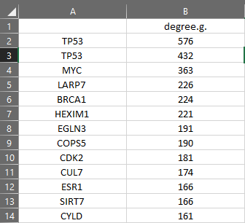
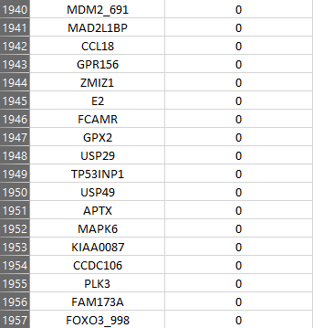
- Results:
For the degree centrality (the higher the number the more important a node is)

Slide 24
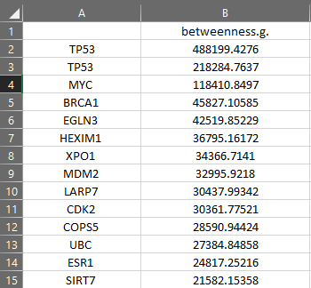
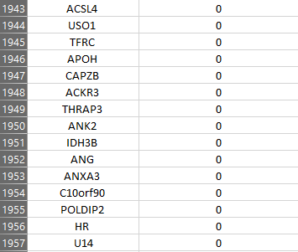
- Results:
For the betweenness centrality (the higher the number the more important a node is)

Slide 25
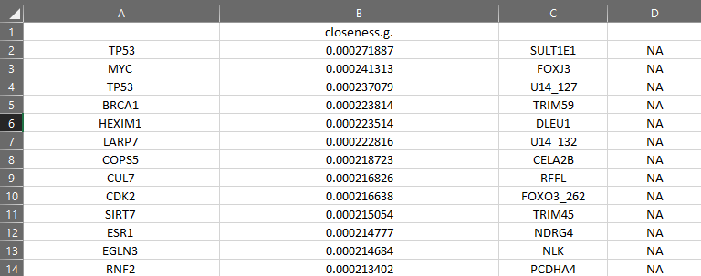
- Results:
For the closeness centrality (the smaller the number the more important a node is) NA means no connation so there will be closeness (∞)

Slide 26
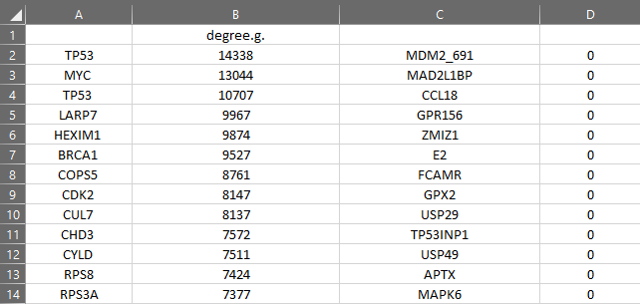
- Results:
For the eigenvector centrality (the higher the number the more important a node is)

Slide 27
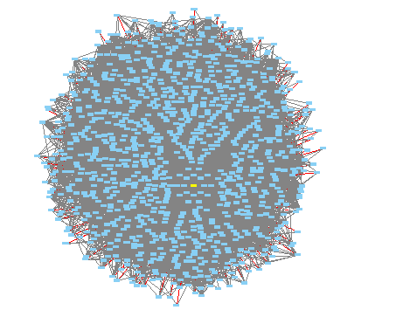
- Conclusion:
these results shows us that the node(protein) TP53(the yellow) is one of the most important proteins in our body it having a high centrality score means it plays a very big role in our protein network which in turn helps us fight off a multitude of viruses and diseases
And with that we reach the end of our project most of the files will be linked below so you can download them and see the results yourself HERE!

Slide 28
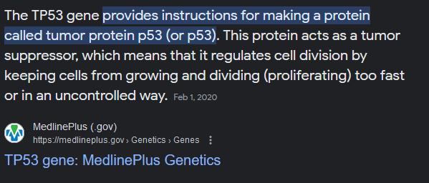
- Conclusion:
And if we were to look up that protein gene we will find the following
Confirming the legitimacy of our project results

Slide 29
Team members: Team number 26
The students who worked on this project are:
Ahmed Mirghani Ahmed Elmakki 22011502:
Data cleaning and Code writing and Report writing
Second year
Ahmed Hussein Hassan dewdar
20225926030: Code assistant
Second year
Hamza Hussain Yousef Omran
22011501:Data set selection and management
Second year
Abdul Rahman alrimali
22011460:Data cleaning assistant
Second year
خالد ربيع عبدالجواد
22010332:dataset assistant
Second year
Samy Adel Ali
22010107:
Team management and role distribution
Second year
Ahmed Taha Mohamed
22010315: Code assistant
Second year
Kareem Mohammed Samy Aboshady
22010378: project preparation
Second year
Mohamed Ramadan Ibrahim
20221372306: project preparation
Third year

